Slide 1

Chapter 19 – Stream Processing

Slide 2

Chapter Goals
To be able to develop filter/map/ reduce strategies for solving data processing problems
To convert between collections and streams
To use function objects for transformations and predicates To work with the Optional type
To be able to express common algorithms as stream operations

Slide 3
Overview
Streams process data by specifying actions.
Library implements the actions using lazy execution. Can skip steps that aren't needed.
Can split work over multiple processors.

Slide 4
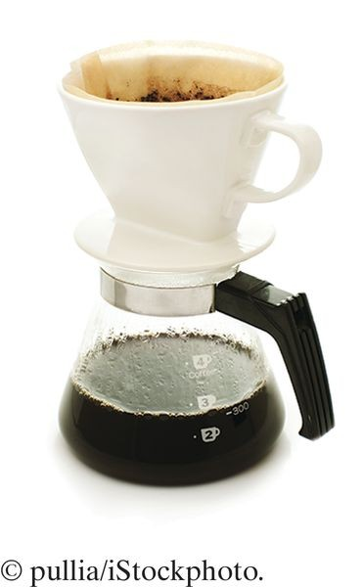
The Stream Concept
Algorithm for counting matches:
List<String> wordList = . . .; long count = 0; for (String w : wordList)
{
if (w.length() > 10) { count++; }
}
With the Java 8 stream library:
Stream<String> words = . . .; long count = words
.filter(w -> w.length() > 10)
.count();
You tell what you want to achieve (Keep the long strings, count them).
You don't dwell on the how (visit each element in turn, if it is long, increment a variable).
"What, not how" is powerful:
Operations can occur in parallel.
The data can be anywhere (e.g. distributed "big data").

Slide 5

Some Facts About Streams
Streams are similar to collections, but... They don't store their own data.
The data comes from elsewhere.
From a collection, a file, a database, data from the internet, ...
Streams were designed to work well with lambda expressions:
stream.filter(w -> w.length() > 10)
Streams are immutable.
Methods such as filter produce new streams.
Stream processing is lazy.

Slide 6
Lazy Processing
Instead of counting the words, let's see some (but not all). Here is how to get the first five:
Stream<String> fiveLongWords = words
.filter(w -> w.length() > 10)
.limit(5);
Bad approach: first generate all long words, and throw most of them away.
Fortunately, stream processing is not bad but lazy.
Works “backwards” and only computes what is necessary.
limit(5) needs an element...
... and filter(....) examines elements until it finds one. That repeats another four times.
And then...nothing.
The other stream elements never get examined.

Slide 7
section_1/StreamDemo.java
import java.io.File;
import java.io.IOException;
import java.util.ArrayList;
import java.util.List;
import java.util.Scanner;
6
7
8
9
10
11
12
13
14
15
16
17
18
19
20
21
22
23
24
25
26
27
28
29
30
31
32
33 }
public class StreamDemo
{
public static void main(String[] args) throws IOException
{
Scanner in = new Scanner(new File("../countries.txt"));
// This file contains one country name per line List wordList = new ArrayList<>();
while (in.hasNextLine()) { wordList.add(in.nextLine()); }
// Now wordList is a list of country names
// Traditional loop for counting the long words long count = 0;
for (String w : wordList)
{
if (w.length() > 10) { count++; }
}
System.out.println("Long words: " + count);
// The same computation with streams count = wordList.stream()
.filter(w -> w.length() > 10)
.count();
System.out.println("Long words: " + count);
}

Slide 8
Program Run:
Long words: 63
Long words: 63

Slide 9
Self Check 19.1
Write a statement to count all overdrawn accounts in a
Stream<BankAccount>.
Answer:
long count = stream
.filter(b -> b.getBalance() < 0)
.count();

Slide 10
Self Check 19.2
Given a stream of strings, how do you remove all empty strings?
Answer:
Stream<String> result = stream.filter( w -> w.length() > 0)

Slide 11
Self Check 19.3
How would you collect the first five strings of length greater than ten in a
List<String> without using streams?
Answer:
List<String> result = new ArrayList<>(); int i = 0;
while (i < strings.size() && result.size() < 5)
{
String s = strings.get(i);
if (s.length() > 10) { result.add(s); }
}

Slide 12
Self Check 19.4
Given a stream of strings, how do you calculate how many have exactly ten characters?
Answer:
long result = stream.filter(
w -> w.length() == 10).count();

Slide 13
Self Check 19.5
Given a stream of strings, how do you find the first one with length equal to ten?
Answer: As a stream, that is
Stream<String> result = stream.filter( w -> w.length() == 10).limit(1);
You will see in Section 19.3 how to get the answer as a string. And Section 19.6 will present an easier way to obtain this result.

Slide 14
Self Check 19.6
Given a stream of strings, how can you find out whether it has at least ten strings with three letters, without counting them all if there are more than ten?
Answer:
boolean atLeastTen = stream.filter( w -> w.length() == 3)
.limit(10).count() == 10;
Because stream processing is lazy, the limit operation stops filtering as soon as ten matches have been found.

Slide 15

Producing Streams
In order to process streams, you first need to have one. Simplest way: the of method:
Stream<String> words = Stream.of("Mary", "had", "a", "little", "lamb"); Stream<Integer> digits = Stream.of(3, 1, 4, 1, 5, 9);
Also works for arrays:
Integer[] digitArray = { 3, 1, 4, 1, 5, 9 }; Stream<Integer> digitStream = Stream.of(digitArray);
This is a stream of Integer objects.
You'll see later how to make a stream of int.
Any collection can be turned into a stream:
List<String> wordList = new ArrayList<>();
// Populate wordList
Stream<String> words = wordList.stream();

Slide 16
Producing Streams
Several utility methods yield streams:
String filename = . . .;
try (Stream<String> lineStream = Files.lines(Paths.get(filename)))
{
...
} // File is closed here
You can make infinite streams:
Stream<Integer> integers = Stream.iterate(0, n -> n + 1);
You can turn any stream into a parallel stream.
Operations such as filter and count run in parallel, each processor working on chunks of the data.
Stream<String> parStream = lineStream.parallel();

Slide 17
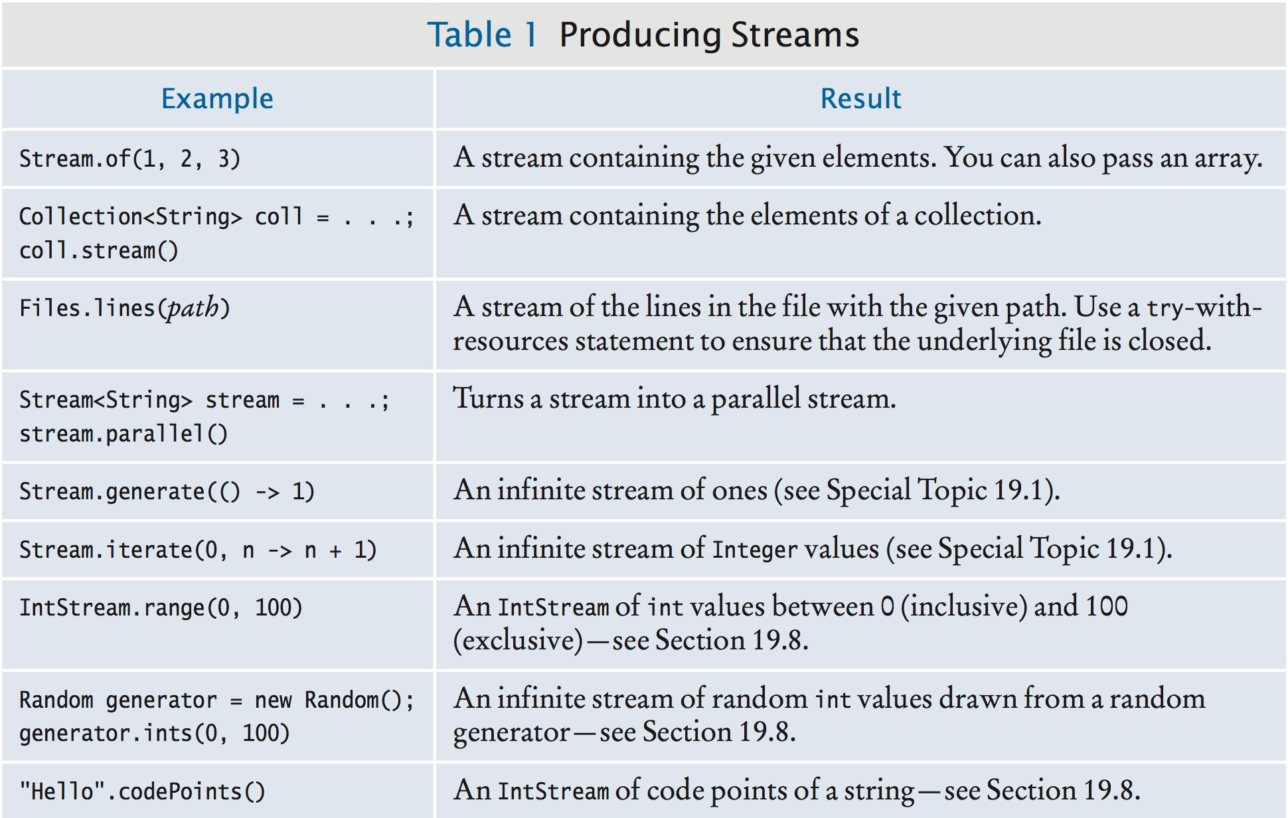
Producing Streams

Slide 18
Self Check 19.7
Write a statement to create a stream of Color objects.
Answer: For example,
Stream<Color> colors = Stream.of( Color.RED, Color.WHITE, Color.BLUE);

Slide 19
Self Check 19.8
Given a list of String objects, use streams to count how many have length less than or equal to three.
Answer:
long count = list.stream()
.filter(w -> w.length() <= 3).count();

Slide 20
Self Check 19.9
Repeat Self Check 8 with an array of strings.
Answer:
long count = Stream.of(array)
.filter(w -> w.length() <= 3).count();

Slide 21
Self Check 19.10
Write a statement to count how many lines in the file input.txt have length greater than 80.
Answer:
try (Stream lines = Files.lines( Paths.get("input.txt")))
{
long count = lines.filter(
l -> l.length() > 80).count();
...
}

Slide 22

Collecting Results
When you are done transforming a stream (e.g. with
filter), want to harvest results.
Some methods (e.g. count, sum) yield a single value. Other methods yield a collection.
Here is how to collect into an array:
String[] result = stream.toArray(String[]::new);
Strange-looking expression String[]::new is a constructor reference (to the array constructor).
Replace String with another class if the stream doesn't contain strings.

Slide 23
Collecting Results
To collect into a List or Set, use collect:
List<String> result = stream.collect(Collectors.toList()); Set<String> result = stream.collect(Collectors.toSet());
The argument to collect is a Collector object.
We'll always use one of the static method of Collectors to get one.
A stream of string can be collected into a single string:
String result = words.collect(Collectors.joining(", "));
// Stream elements separated with commas

Slide 24
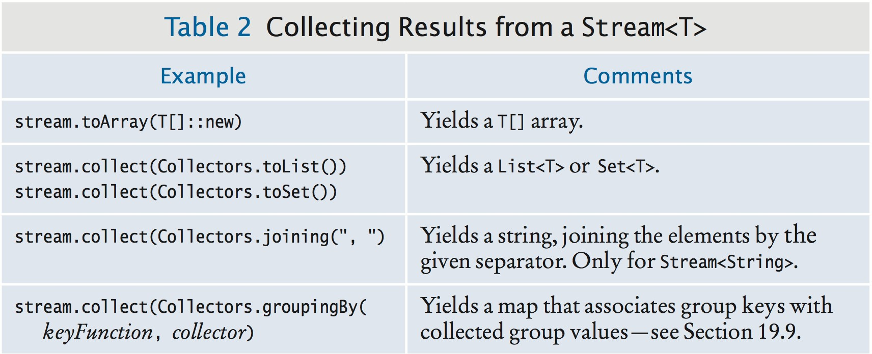
Collecting Results

Slide 25
Self Check 19.11
Collect all strings of length greater than ten from a list of strings and store them in another list.
Answer:
List<String> result = list.stream()
.filter(w -> w.length() > 10)
.collect(Collectors.toList());

Slide 26
Self Check 19.12
Repeat Self Check 11, but collect the result in a set.
Answer:
Set<String> result = list.stream()
.filter(w -> w.length() > 10)
.collect(Collectors.toSet());

Slide 27
Self Check 19.13
Find the first string of length greater than ten in a list of strings. Use filter and limit, then convert the stream to a list and retrieve the result. Assume that there is at least one such string.
Answer:
String result = list.stream()
.filter(w -> w.length() > 10)
.limit(1)
.collect(Collectors.toList())
.get(0);

Slide 28
Self Check 19.14
Repeat Self Check 13, but use toArray.
Answer:
String result = list.stream()
.filter(w -> w.length() > 10)
.limit(1)
.toArray(String[]::new)[0];

Slide 29
Self Check 19.15
The solutions to Self Check 13 and Self Check 14 would work even if you omitted the call to limit. Why would that not be a good idea?
Answer: If you omitted the call to limit(1), all strings of length greater than 10 would be collected and converted to a list or array. With the call to limit, collecting stops as soon as the first match has been found.

Slide 30
Tip: One Stream Operation Per Line
It's best to put one stream operation per line:
List<String> result = list.stream() // Create the stream
.filter(w -> w.length() > 10) // Keep long strings
.limit(50) // Keep only the first fifty.
.collect(Collectors.toList()); // Turn into a list
If you cram as much as possible into one line, it is tedious to figure out the steps:
List<String> result = list.stream().filter(w -> w.length() > 10).limit(50)
.collect(Collectors.toList()); // Don’t use this formatting style

Slide 31

Stream Tranformations
Life cycle of a stream:
Create stream.
Transform stream (possibly multiple times). Collect results.

Slide 32
Stream Tranformations - map
map transforms stream by applying function to each element.
Turn all words into lowercase:
Stream<String> words = Stream.of("A", "Tale", "of", "Two", "Cities"); Stream<String> lowerCaseWords = words.map(w -> w.toLowerCase());
// "a", "tale", "of", "two", "cities"
Remove vowels from all words:
Stream<String> consonantsOnly = lowerCaseWords.map( w -> w.replaceAll("[aeiou]", ""));
// "", "tl", "f", "tw", "cts"
Get the length of each element:
Stream<Integer> consonantCount = consonantsOnly.map(w -> w.length());
// 0, 2, 1, 2, 3

Slide 33
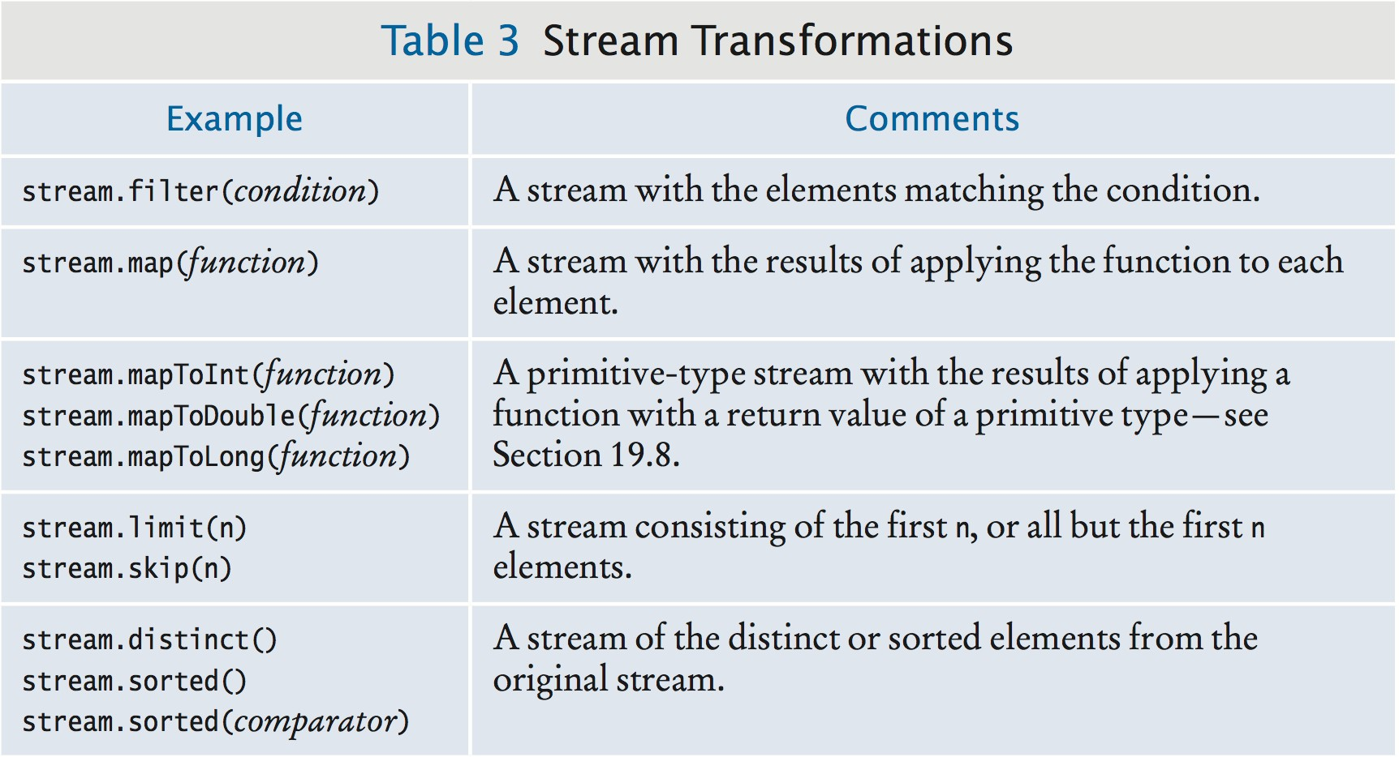
Stream Transformations - Table of Examples

Slide 34
More Stream Transformations
Applying map yields a stream with the same number of elements.
filter only retains matching elements:
Stream<String> aWords = words.filter(w -> w.substring(0, 1).equals("a"));
// Only the words starting with "a"
limit takes the first n:
Stream<String> first100aWords = aWords.limit(100);
skip takes all but the first n:
Stream<String> allButFirst100aWords = aWords.skip(100);
distinct yields a stream with duplicates removed:
Stream<String> words = Stream.of(
"how much wood could a wood chuck chuck".split(" ")); Stream<String> distinctWords = words.distinct();
// "how", "much", "wood", "could", "a", "chuck"
sorted yields a new stream in which the elements are

Slide 35
sorted:
Stream<String> sortedWords = distinctWords.sorted();
// "a", "chuck", "could", "how", "much", "wood"
Element type must be Comparable
Or supply a comparator: distinctWords.sorted((s, t) -> s.length() - t.length())

Slide 36
section_4/StreamDemo.java
import java.io.IOException;
import java.nio.file.Files;
import java.nio.file.Paths;
import java.util.List;
import java.util.stream.Collectors;
import java.util.stream.Stream;
7
8
9
10
11
12
13
14
15
16
17
18
19
20
21
22
23
24
public class StreamDemo
{
public static void main(String[] args) throws IOException
{
try (Stream lines = Files.lines(Paths.get("../countries.txt")))
{ // Read the lines List result = lines
.filter(w -> w.length() > 10) // Keep only long words
.map(w -> w.substring(0, 7)) // Truncate to seven characters
.map(w -> w + "...") // Add ellipses
.distinct() // Remove duplicates
.limit(20) // Keep only the first twenty
.collect(Collectors.toList()); // Collect into a list System.out.println(result);
}
}
}
Program Run:
[Afghani..., America..., Antigua..., Bahamas..., Bosnia ...,
British..., Burkina..., Cayman ..., Central..., Christm...,
Cocos (..., Congo, ..., Cook Is..., Cote d’..., Czech R...,
Dominic..., El Salv..., Equator..., Falklan..., Faroe I...]

Slide 37
Self Check 19.16
Given a stream of words, get a stream of all that start with a or A, converted to lowercase. Provide two solutions, one applying filter before map and one after.
Answer:
Stream<String> result = words
.filter(w -> w.substring(0, 1)
.equalsIgnoreCase("a"))
.map(w -> w.toLowerCase());
or
Stream<String> result = words
.map(w -> w.toLowerCase())
.filter(w -> w.substring(0, 1)
.equals("a"));

Slide 38
Self Check 19.17
Given a stream of words, produce a stream of Integer values containing the lengths of the words.
Answer:
Stream<Integer> result = words
.map(w -> w.length());

Slide 39
Self Check 19.18
Given a list of strings, get a list of the first ten in sorted order.
Answer:
List<String> result = list.stream()
.sorted()
.limit(10)
.collect(Collectors.toList());

Slide 40
Self Check 19.19
Given a list of words, how do you find how many distinct words there are of length equal to three?
Answer:
int result = list.stream()
.filter(w -> w.length() == 3)
.distinct()
.count();

Slide 41
Self Check 19.20
How can you solve Self Check 19 without streams?
Answer: Put all words of length 3 into a set and get its size:
Set<String> words = new HashSet<>(); for (String w : list)
{
if (w.length() == 3)
{
words.add(w);
}
}
int result = words.size();

Slide 42
Common Error: Don't Use a Terminated Stream
Once you apply a terminal operation, a stream is “used up”. Can no longer apply any stream operations.
Easy mistake if you have a reference to an intermediate stream:
Stream<String> stream = list.stream();
List<String> result1 = stream.limit(50).collect(Collectors.toList());
// Save the first fifty stream = stream.skip(50);
// Error—the stream can no longer be used
To avoid the error, use “pipeline notation”:
result = create(...)
.transform1(...)
.transform2(...)
.terminalOperation(...)
If you want to do what the example tried to do, you need two streams:

Slide 43
List<String> result1 = list.stream()
.limit(50)
.collect(Collectors.toList()); // This stream can no longer be used List<String> result2 = list.stream() // Create another stream
.skip(50)
.limit(50)
.collect(Collectors.toList());

Slide 44
Lambda Expressions
Have seen lambda expressions in filter and map
methods such as:
w -> w.length() > 10
Like a static function.
Left side of -> operator is a parameter variable.
Right side is code to operate on the parameter and compute a result.
When used with a type like Stream<String>, compiler can determine type.
Otherwise, you can specify the type, like:
(String w) -> w.length() > 10
Multiple parameters are enclosed in parentheses:
(v, w) -> v.length() - w.length()

Slide 45
This expression can be used with the sorted method in the
Stream class to sort strings by length:
Stream<String> sortedWords = distinctWords.sorted( (v, w) -> v.length() - w.length());
// "a", "how", "much", "wood", "could", "chuck"

Slide 46
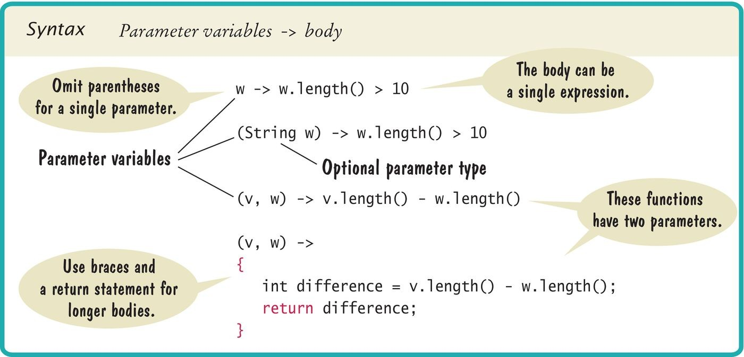
Syntax 19.1 Lambda Expressions

Slide 47
Self Check 19.21
Write a lambda expression for a function that computes the average of two numbers.
Answer:
(x, y) -> (x + y) / 2.0

Slide 48
Self Check 19.22
Write a lambda expression that tests whether a word starts and ends with the same letter.
Answer:
w -> w.substring(0, 1).equals( w.substring(w.length() - 1))

Slide 49
Self Check 19.23
What does this lambda expression do?
s -> s.equals(s.toUpperCase())
Answer: It is a predicate that tests whether a string is in uppercase.

Slide 50
Self Check 19.24
Assuming that words is a Stream<String>, what is the result of this call?
words.filter(s -> s.equals(s.toUpperCase()))
Answer: It is a stream consisting of all words that are entirely in uppercase.

Slide 51
Self Check 19.25
Assuming that words is a Stream<String>, what is the result of this call?
Answer: It is a Stream<Boolean> with values Boolean.TRUE and Boolean.FALSE (the wrappers for true and false), depending on whether the elements of words were entirely in uppercase or not.
words.map(s -> s.equals(s.toUpperCase()))

Slide 52
Method Expressions
Common to have lambda expressions that just invoke a method.
Use method expression: ClassName::methodName:
String::toUpperCase
Parameters are added “at the right places”:
(String w) -> w.toUpperCase()
If method has a parameter, the lambda expression gets two parameters:
String::compareTo
is the same as:
(String s, String t) -> s.compareTo(t)
Also works with static methods:
Double::compare

Slide 53
is the same as:
(double x, double y) -> Double.compare(x, y)
Can have an object to the left of :: symbol:
System.out::println
is the same as:
x -> System.out.println(x)

Slide 54
Constructor Expressions
Like method expression, with special method name new. For example,
is equivalent to a lambda expression that invokes the
BankAccount constructor.
Which constructor?
Depends on context—could be:
BankAccount::new
() -> new BankAccount()
or:
b -> new BankAccount(b)
Constructor expressions can construct arrays:
String[]::new
Same as:

Slide 55
Used to overcome limitation of Java generics—can't construct array of generic type.
(n: int) -> new String[n]

Slide 56
Higher-Order Functions
A “function” that consumes and/or produces “functions”. Example: filter consumes function:
public static <T> List<T> filter(List<T> values, Predicate<T> p)
{
List<T> result = new ArrayList<>(); for (T value : values)
{
if (p.test(value)) { result.add(value); }
}
return result;
}
Here, Predicate is a standard functional interface:
public interface Predicate<T>
{
boolean test(T arg);
}
Typical use:
List<String> longWords = filter(wordList, w -> w.length() > 10);

Slide 57
Higher-Order Functions
Suppose we want to find all strings that contain the word
"and":
List<String> andWords = filter(wordList, w -> w.indexOf("and") >= 0);
What if we want to find another word?
Can write a method that yields the predicate for an arbitrary target:
public static Predicate<String> contains(String target)
{
return s -> s.indexOf(target) >= 0;
}
Pass the result to a method expecting a Predicate:
List<String> andWords = filter(wordList, contains("and"));
contains is also a higher-order function.

Slide 58
Method Expressions and Comparators
Comparator.comparing makes a comparator from an extractor function:
Comparator<String> comp = Comparator.comparing(t -> t.length())
Same as:
Comparator<String> comp = (v, w) -> v.length() - w.length();
Note that the extractor function makes a single method call. Write as method reference:
Comparator.comparing(String::length)
Reads nicely: the comparator that compares strings by their length.
Can add a secondary comparison with thenComparing:
Collections.sort(countries, Comparator.comparing(Country::getContinent)
.thenComparing(Country::getName));

Slide 59
Countries are compared first by continent.
If the continents are the same, they are compared by name.
Easy to read, easy to write.
Thanks to lambda expressions, method expressions, higher order functions.

Slide 60
The Optional Type
In Java, common to use null to denote absence of result.
Drawback: NullPointerException when programmer forgets to check.
String result = oldFashionedMethod(searchParameters);
// Returns null if no match int length = result.length();
// Throws a NullPointerException when result is null
Stream library uses Optional type when a result may not be present.
Example: First string of length > 10:
words.filter(w -> w.length() > 10).findFirst()
What if there is none? An Optional<String> either contains a string or an indication that no value is present.
Optional<String> optResult = words
.filter(w -> w.length() > 10)
.findFirst();

Slide 61
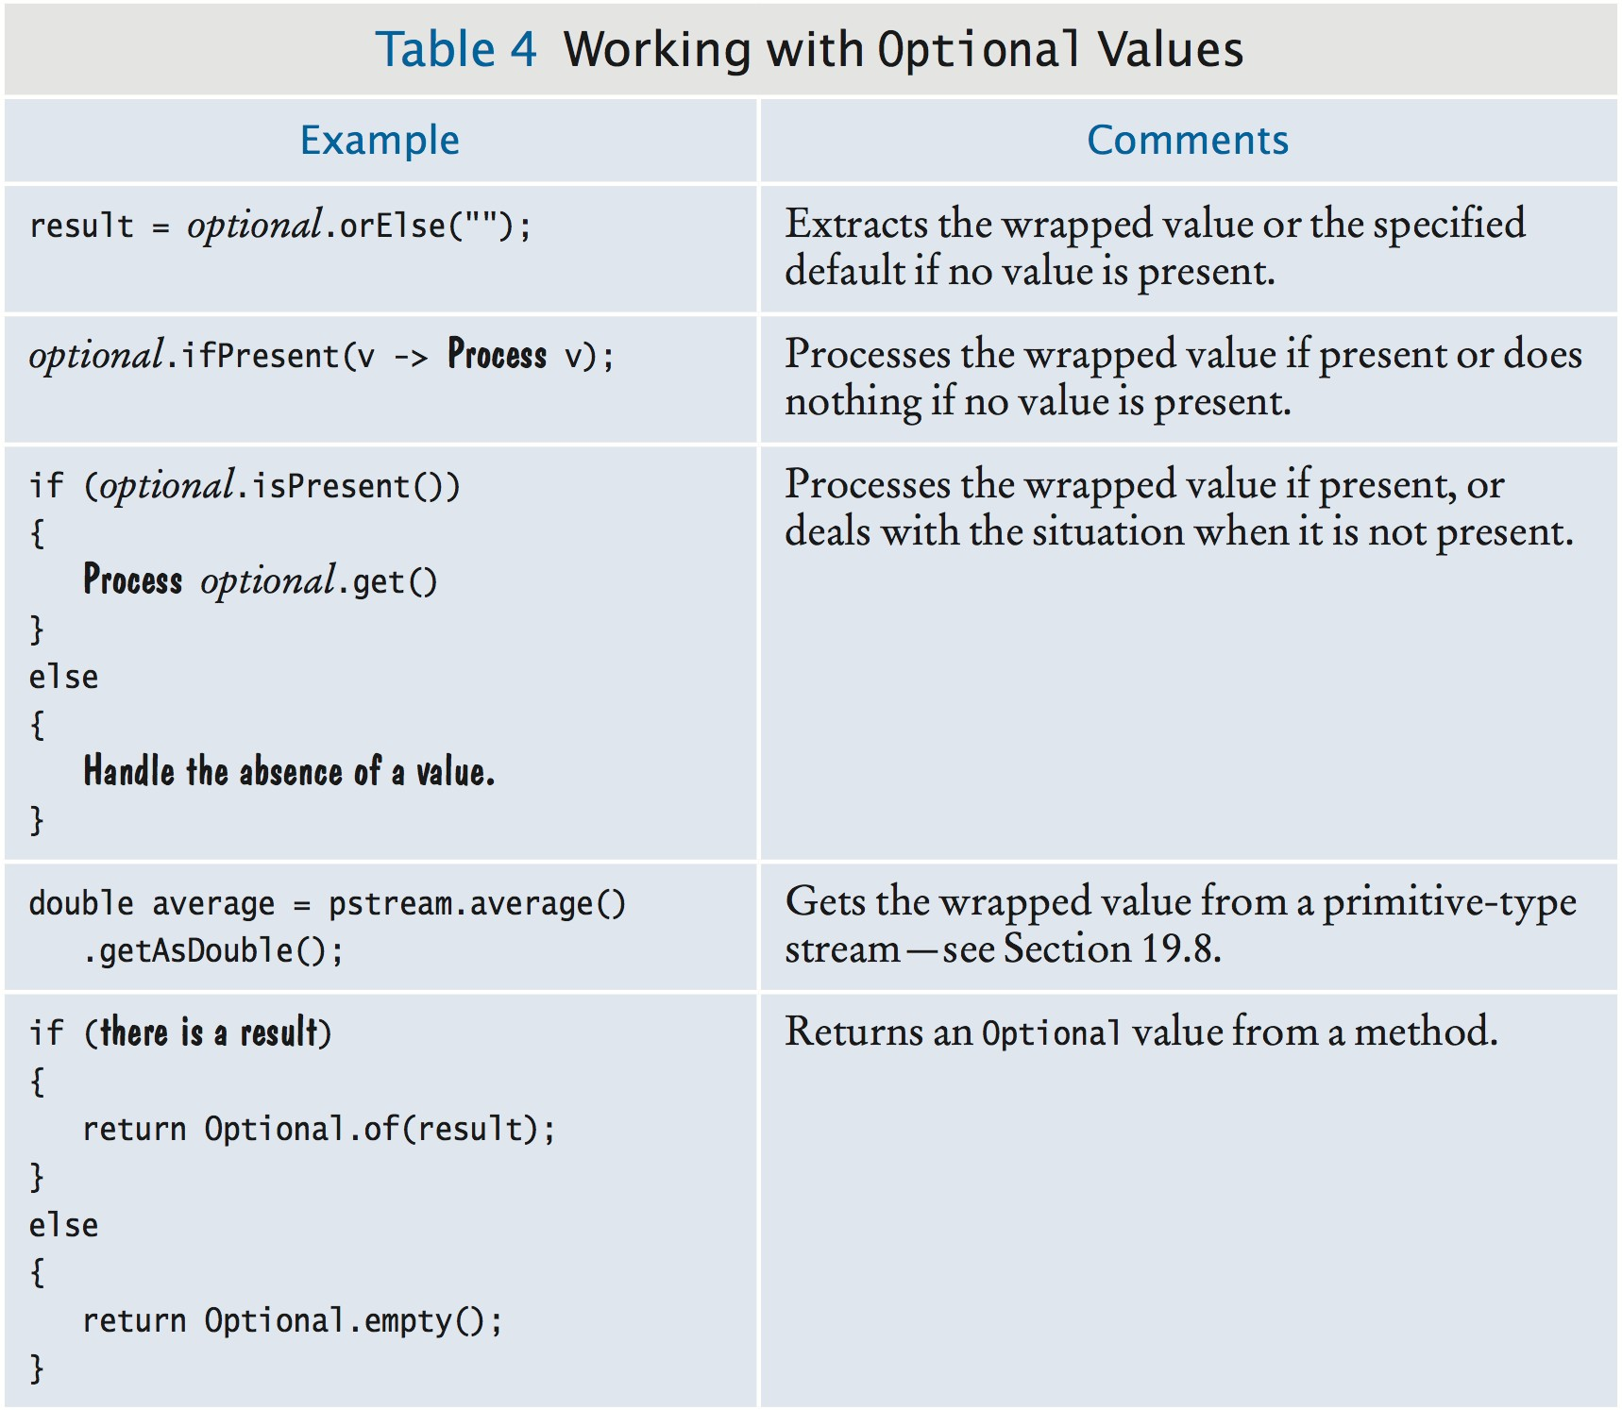
Optional Values

Slide 62
Working with Optional
Work with it, not against it. (That is, don't treat it like a potentially null reference.)
orElse extracts the value or an alternative if there is none:
int length = optResult.orElse("").length();
ifPresent passes on the value to a function; does nothing if there is none:
optResult.ifPresent(v -> results.add(v));
If neither of these works, use isPresent to test if there is a value and get to get it:
if (optResult.isPresent())
{
System.out.println(optResult.get());
}
else
{
System.out.println("No element");
}

Slide 63
Returning Optional
Declare return type as Optional<T>.
If there is a result, return Optional.of(result). Otherwise return Optional.empty().
public static Optional<Double> squareRoot(double x)
{
if (x >= 0) { return Optional.of(Math.sqrt(x)); } else { return Optional.empty(); }
}

Slide 64
Self Check 19.26
Set word to the first word in the list wordList containing the letter a, or to the empty string if there is no match.
Answer:
String word = wordList.stream()
.findFirst(w -> w.contains("a"))
.orElse("");

Slide 65
Self Check 19.27
Repeat Self Check 26 using ifPresent.
Answer:
String word = ""; wordList.stream()
.findFirst(w -> w.contains("a"))
.ifPresent(v -> { word = v; });
Note that the previous solution was better because it did not involve any “side effect”.

Slide 66
Self Check 19.28
Repeat Self Check 26 using isPresent.
Answer:
Optional<String> optResult = wordList.stream()
.findFirst(w -> w.contains("a")); String word = "";
if (optResult.isPresent())
{
word = optResult.get();
}

Slide 67
Self Check 19.29
Set word to the tenth word in the list wordList containing the letter a, or to the empty string if there is no such string. Don’t use collect.
Answer:
String word = wordList.stream()
.filter(w -> w.contains("a"))
.skip(9)
.findFirst()
.orElse("");

Slide 68
Self Check 19.30
Write a method reciprocal that receives a parameter x of type double and returns an Optional<Double> containing 1 / x if x is not zero.
Answer:
public static Optional<Double> reciprocal(double x)
{
if (x == 0) { return Optional.empty(); } else { return Optional.of(1 / x); }
}

Slide 69
Other Terminal Operations
findAny is like findFirst, but is faster on parallel streams.
result = words
.parallel()
.filter(w -> w.length() > 10)
.filter(w -> w.endsWith("y"))
.findAny()
.orElse("");
max/min require a comparator and return an Optional
(since the input may be empty):
Optional<String> result = words.max((v, w) -> v.length() - w.length());
allMatch/anyMatch/noneMatch check a predicate:
boolean result = words.allMatch(w -> w.contains("e"));
// result is true if all words contain the letter e

Slide 70
Self Check 19.31
Rewrite the example for the findAny operation at the beginning of this section so that the filter method is only called once.
Answer:
result = words.parallel()
.filter(w -> w.length() > 10 && w.endsWith("y"))
.findAny()
.orElse("");

Slide 71
Self Check 19.32
How can you check whether any words start with the letter q and end with the letter y without calling findAny?
Answer:
boolean result = words.anyMatch( w.startsWith("q") && w.endsWith("y"));

Slide 72
Self Check 19.33
What is wrong with the following code?
Stream<String> qys = wordList.stream()
.filter(w -> w.startsWith("q"))
.filter(w -> w.endsWith("y")); if (qys.count() > 0)
{
System.out.println(qys.findAny().get());
}
Answer: Once you invoke the terminal operation qys.count(), you can no longer invoke any operations on the stream.

Slide 73
Self Check 19.34
How can you get two words starting with q and ending with y?
Answer: You can’t call findAny twice, so you should use limit to limit the stream to two results and then collect it to an array or list.
List<String> result = words
.filter(w -> w.startsWith("q") && w.endsWith("y"))
.limit(2)
.collect(Collectors.toList());

Slide 74
Self Check 19.35
An operation short circuits if it stops looking at inputs that can no longer change the result. For example, the Boolean operator && short circuits when the first
operand is false. Which of allMatch, anyMatch, and noneMatch can short circuit?
Answer: They all can short circuit: allMatch returns false as soon as it finds an element that doesn’t match, and anyMatch and noneMatch return as soon as they find an element that matches, with return values true and false respectively.

Slide 75
Primitive-Type Streams
Inefficient to have streams of number wrappers such as
Stream<Integer>.
For example, numbers.map(x -> x * x) requires unboxing and boxing for each element.
IntStream, DoubleStream, DoubleStream work with
int, long, double values without boxing.
No stream classes for byte, short, long, char, or
float.

Slide 76
Creating Primitive-Type Streams
Can create from individual numbers, or an array:
IntStream stream = IntStream.of(3, 1, 4, 1, 5, 9); int[] values = . . .;
stream = IntStream.of(values);
range yields a contiguous range of integers:
IntStream stream = IntStream.range(a, b);
// Stream contains a, a + 1, a + 2, ..., b -1
Random generator yields infinite stream of random numbers:
Random generator = new Random();
IntStream dieTosses = generator.ints(1, 7);
String yields stream of Unicode code points:
IntStream codePoints = str.codePoints();
Aside: This is the best way of getting the code points of a string in the Java API!
Much better than charAt which only yields 16-bit code units of the variable-length UTF-16 encoding.

Slide 77
Mapping Primitive-Type Streams
IntStream.map with an int -> int function yields another IntStream.
IntStream stream = IntStream.range(0, 20)
.map(n -> Math.min(n, 10));
// A stream with twenty elements 0, 1, 2, ..., 9, 10, 10, ..., 10
When the function yields objects, use mapToObj:
String river = "Mississippi"; int n = river.length();
Stream<String> prefixes = IntStream.range(0, n)
.mapToObj(i -> river.substring(0, i));
// "", "M", "Mi", "Mis", "Miss", "Missi", ...
Also have mapToDouble, mapToLong if the function yields
double, and long values.
Think of IntStream.range(a, b).mapXXX as an equivalent of a for loop that yields a value in each iteration.
Use mapToInt/mapToLong/mapToDouble with streams of objects when the map function yields primitive type values.
Use boxed to turn into a stream of objects.

Slide 78
Processing Primitive-Type Streams
Stream methods for primitive-type streams have modified parameters/return types.
For example, IntStream.toArray returns an int[] and doesn't require a constructor.
Four additional methods sum, average, max, and min
(without comparators).
Last three return
OptionalInt/OptionalLong/OptionalDouble:
double average = words
.mapToInt(w -> w.length())
.average()
.orElse(0);

Slide 79
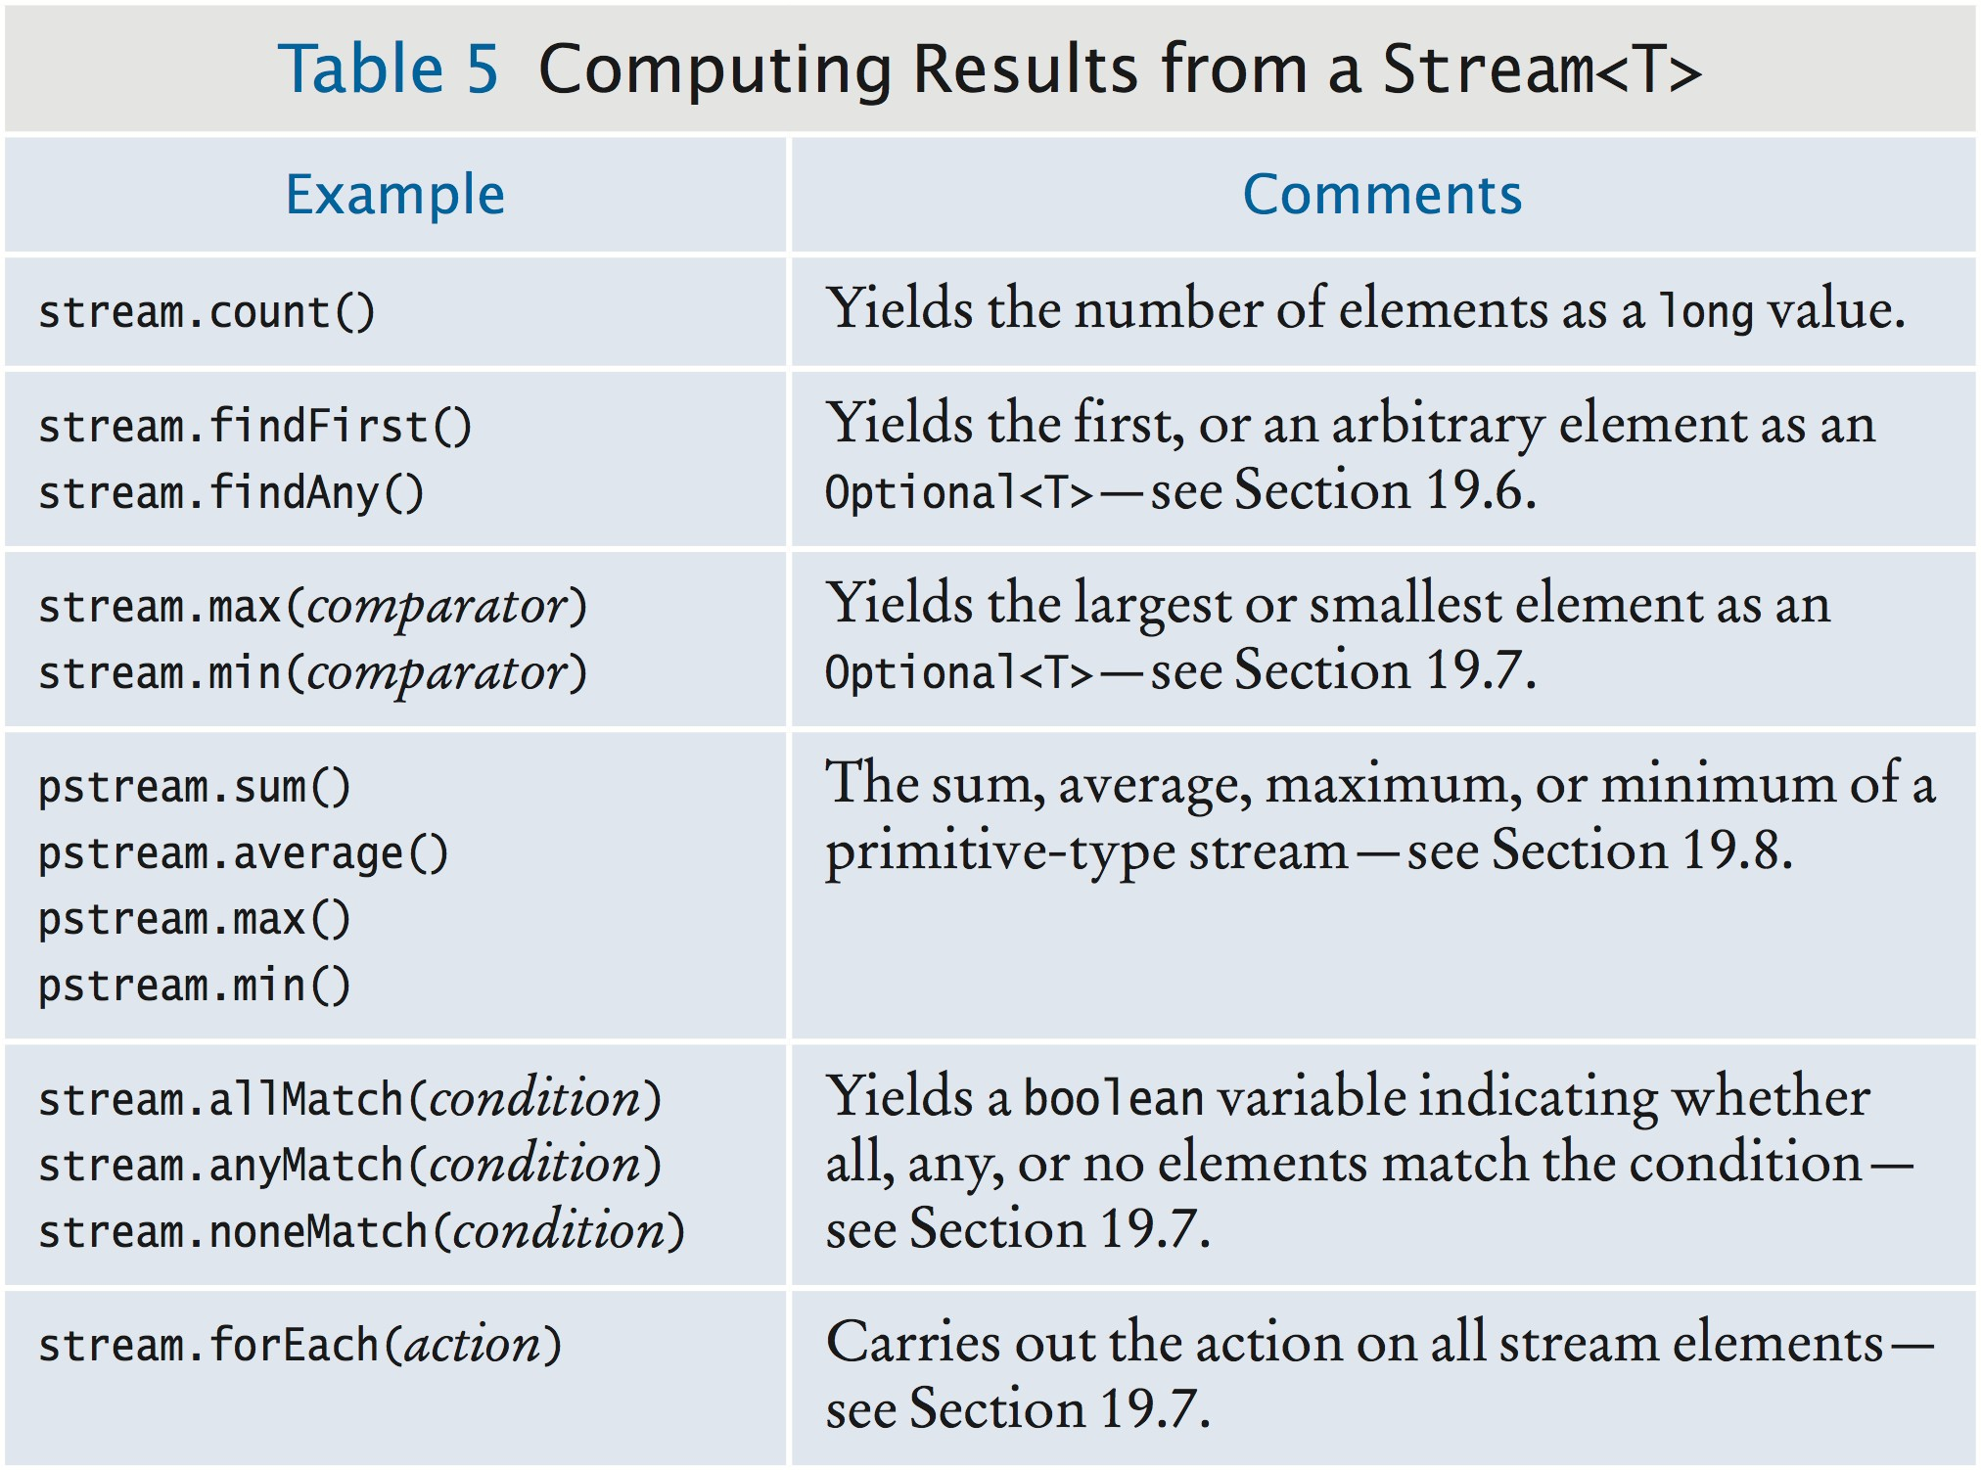
Computing Results

Slide 80
Self Check 19.36
Given a list of BankAccount objects, use streams to find the sum of all balances.
Answer:
double sum = accounts.stream()
.mapToDouble(a -> a.getBalance())
.sum();

Slide 81
Self Check 19.37
Given a list of BankAccount objects, use streams to find the average balance.
Answer:
double average = accounts.stream()
.mapToDouble(a -> a.getBalance())
.average()
.orElse(0);

Slide 82
Self Check 19.38
Given a list of words, find the length of the longest one.
Answer:
int longestLength = wordList.stream()
.mapToInt(w -> w.length())
.max()
.orElse(0);

Slide 83
Self Check 19.39
Given a list of words, find the length of the shortest word starting with the letter z.
Answer:
int longestLength = wordList.stream()
.filter(w -> w.startsWith("z"))
.mapToInt(w -> w.length())
.min()
.orElse(0);

Slide 84
Grouping Results
So far, results were either a value or a collection. Sometimes, want to split result into groups.
Example: Group all words with the same first letter together. Use:
stream.collect(Collectors.groupingBy(function))
The function produces a key for each element. The result is a a map.
Map values are collections of elements with the same key.
Map<String, List<String>> groups = Stream.of(words)
.collect(Collectors.groupingBy(
w -> w.substring(0, 1))); // The function for extracting the keys
groups.get("a") is a list of all words starting with a.

Slide 85
Processing Groups
Nice to split result into groups.
Even nicer: Can process each group.
Pass a collector to Collectors.groupingBy. Example: Group into sets, not lists:
Map<String, Set<String>> groupOfSets = Stream.of(words)
.collect(Collectors.groupingBy(
w -> w.substring(0, 1), // The function for extracting the keys
Collectors.toSet())); // The group collector
The groupingBy collector collects the stream into groups. The toSet collector collects each group int a set.

Slide 86
section_9/GroupDemo.java
import java.util.List;
import java.util.Map;
import java.util.Optional;
import java.util.Set;
import java.util.stream.Stream;
import java.util.stream.Collectors;
7
8
9
10
11
12
13
14
15
16
17
18
19
20
21
22
23
24
25
26
27
28
29
30
31
32
33
34
35
36
public class GroupDemo
{
public static void main(String[] args)
{
String[] words = ("how much wood would a woodchuck chuck "
+ "if a woodchuck could chuck wood").split(" ");
Map<String, List<String>> groups = Stream.of(words)
.collect(Collectors.groupingBy( w -> w.substring(0, 1)));
System.out.println("Lists by first letter: " + groups);
Map<String, Set<String>> groupOfSets = Stream.of(words)
.collect(Collectors.groupingBy(
w -> w.substring(0, 1), // The function for extracting the keys Collectors.toSet())); // The group collector
System.out.println("Sets by first letter: "
+ groupOfSets);
Map<String, Long> groupCounts = Stream.of(words)
.collect(Collectors.groupingBy( w -> w.substring(0, 1), Collectors.counting()));
System.out.println("Counts by first letter: " groupCounts);
Map<String, Optional<String>> groupLongest = Stream.of(words)
.collect(
Collectors.groupingBy(

Slide 87
Program Run:
Lists by first letter: {a=[a, a], c=[chuck, could, chuck],
w=[wood, would, woodchuck, woodchuck, wood], h=[how], i=[if], m=[much]} Sets by first letter: {a=[a], c=[could, chuck], w=[would, woodchuck, wood], h=[how], i=[if], m=[much]}
Counts by first letter: {a=2, c=3, w=5, h=1, i=1, m=1}
Longest word by first letter: {a=Optional[a], c=Optional[chuck], w=Optional[woodchuck], h=Optional[how], i=Optional[if], m=Optional[much]}

Slide 88
Self Check 19.40
Suppose words contains the strings "Mary", "had", "a", "little", "lamb". What are the contents of groups in the first example of this section?
Answer: It is a map:
{ "M" -> ["Mary"], "h" -> ["had"], "a" ->
["a"], "l" -> ["little", "lamb"] }.

Slide 89
Self Check 19.41
With the same contents for words, what are the contents of groupCounts in the third example?
Answer: It is a map:
{ "M" -> 1, "h" -> 1, "a" -> 1, "l" -> 2 }.

Slide 90
Self Check 19.42
Given a list of strings, make a map with keys 1, 2, 3, ..., so that the value for the key n is a list of all words of length n.
Answer:
Map<Integer, List<String>> groups = wordList.stream()
.collect(Collectors.groupingBy( w -> w.length));

Slide 91
Self Check 19.43
Associate with each letter the average length of words in words that start with that letter.
Answer:
Map<String, Double> averages = Stream.of(words)
.collect(Collectors.groupingBy( w -> w.substring(0, 1), Collectors.averagingInt(
w -> w.length())));

Slide 92
Self Check 19.44
Associate with each letter a string containing all words in words starting with that letter, separated by commas.
Answer:
Map<String, String> wordsStartingWith = Stream.of(words)
.collect(Collectors.groupingBy( w -> w.substring(0, 1), Collectors.joining(", ")));

Slide 93
Collecting Counts and Sums
groupCounts.get("a") is the number of words that start with an a.
To sum up some aspect of group values, use summingInt, summingDouble, and summingLong:
Use Collectors.counting() to count the group values:
Map<String, Long> groupCounts = Stream.of(words)
.collect(Collectors.groupingBy( w -> w.substring(0, 1), Collectors.counting()));
Map<String, Long> groupSum = countries.collect( Collectors.groupingBy(
c -> c.getContinent(), // The function for extracting the keys Collectors.summingLong(
c -> c.getPopulation()))); // The function for getting the summands
groupSum.get("Asia") is the total population of Asian countries.

Slide 94
Collecting Average, Maximum, Minimum
The Collectors methods averagingInt, averagingDouble, and averagingLong work just like summingXxx.
Return 0 for empty groups (not an Option). Average word length grouped by starting character:
Map<String, Double> groupAverages = Stream.of(words)
.collect(Collectors.groupingBy( w -> w.substring(0, 1),
Collectors.averagingInt(String::length)));
maxBy, minBy use a comparison function and return
Optional results:
Map<String, Optional<String>> groupLongest = Stream.of(words)
.collect(
Collectors.groupingBy(
w -> w.substring(0, 1), // The function for extracting the keys Collectors.maxBy(
(v, w) -> v.length() - w.length()))); // The comparator function

Slide 95
Parallel Streams
Use parallelStream on a collection:
Stream<String> parallelWords = words.parallelStream();
Or use parallel on any stream:
Stream<String> parallelWords = Stream.of(wordArray).parallel();
When the terminal method executes, operations are parallelized.
Intent: Same result as when run sequentially.
Just faster because the work is distributed over available processors.
Example:
long result = wordStream.parallel()
.filter(w -> w.length() > 10)
.count();
The underlying data is partitioned in n regions.
The filtering and counting executes concurrently.
When all counts are ready, they are combined.

Slide 96
Effective Parallelization
Streams from arrays and lists are ordered. Results are predictable, even on parallel streams.
Use findAny instead of findFirst if you don't care about ordering.
Call unordered to speed up limit or distinct:
Stream<String> sample = words.parallelStream().unordered().limit(n);
Use groupingByConcurrent to speed up grouping if you don't care about the order in which the values are processed:
Map<Integer, Long> wordCounts = words.parallelStream()
.collect(
Collectors.groupingByConcurrent( String::length, Collectors.counting()));

Slide 97
Self Check 19.45
How do you compute the sum of all positive values in an array of integers?
Answer:
int sum = IntStream.of(values)
.filter(n -> n > 0)
.sum();

Slide 98
Self Check 19.46
How do you find the position of the last space in a string, using streams?
Answer: There are two possible approaches. You can collect all matches and then pick the last one.
int[] positions = IntStream
.range(0, str.length)
.filter(i -> str.charAt(i) == ' ')
.toArray(); int lastPos = -1;
if (positions.length > 0) { lastPos = positions[positions.length - 1]; }
Or you can move backward through the string:
int n = str.length();
int lastPos = IntStream.range(0, n)
.filter(i -> str.charAt(n - 1 - i) == ' ')
.findFirst()
.orElse(-1);

Slide 99
Self Check 19.47
How do you get the smallest area of any country from a list of Country objects,
assuming that the Country class has a method public getArea()? How do you get the country with that area?
Answer:
double
double smallest = countries.stream()
.mapToDouble(c -> c.getArea())
.min();
To get the country, you could now search:
Optional<Country> smallestCountry
= countries.stream()
.findAny(c -> c.getArea() == smallest);
But it is more efficient to search for the country with the minimal area. Then you need to specify a comparator.
Optional<Country> smallestCountry
= countries.stream()
.min((c, d) -> Double.compare( c.getArea(), d.getArea()));
Or, using Special Topic 19.4:

Slide 100
Optional<Country> smallestCountry
= countries.stream()
.min(Comparator.comparing( c -> c.getArea()));

Slide 101
Self Check 19.48
Someone proposes the following way to find the smallest element in a stream:
smallest = stream.sorted().limit(1).findAny().get();
Will it work? If so, is it a good idea?
Answer: Yes, it will work, provided there is at least one element in the stream. But it’s not a good idea because sorting is much less efficient than computing the minimum.

Slide 102
Self Check 19.49
Why can’t one use the distinct method to solve the problem of removing adjacent duplicates from a stream?
Answer: The distinct method removes all duplicates, not just adjacent ones.

